Slide 1
GIT version control
-- everything-is-local
-- distributed-is-the-new-centralized -- distributed-even-if-your-workflow-isn’t --local-branching-on-the-cheap
- Sparsh Priyadarshi GIT fan

Slide 2
Bit about Version Control… what, why ?
Collaborate on code files, make changes, revert to previous version, add , remove modifications and most importantly Track all of this history. And obviously do not overwrite on some one else’ work :P

Slide 3
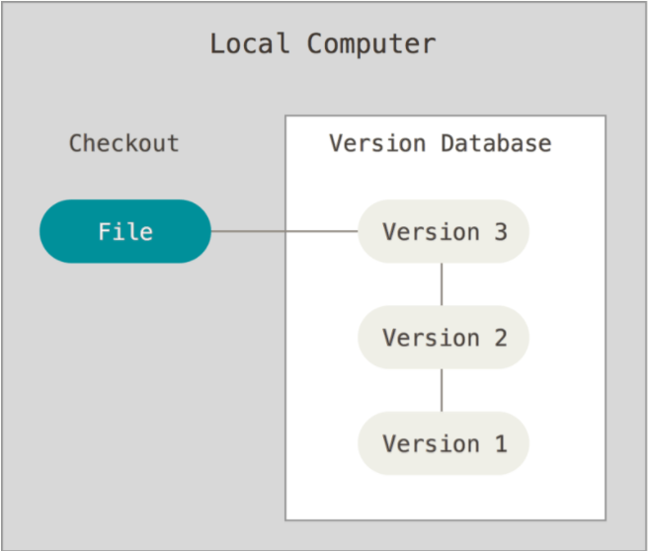
Bit about version control… Local Version Control

Slide 4
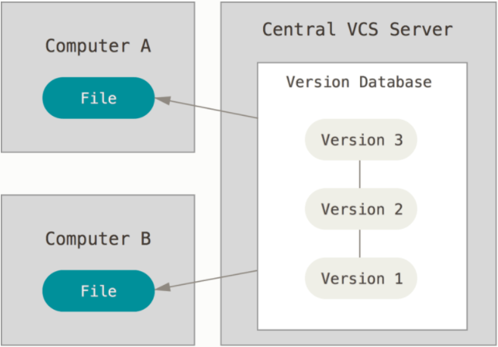
Bit about version control… Centralized Version Control
SVN

Slide 5
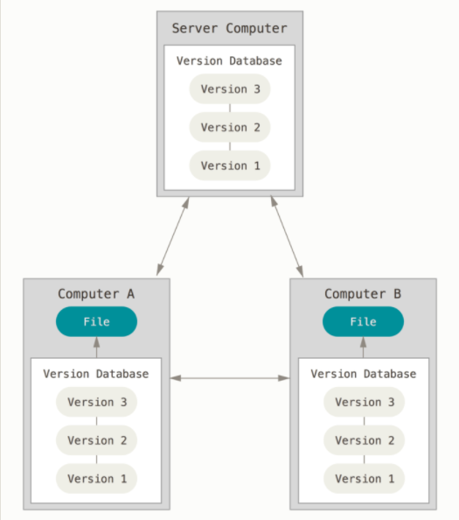
Bit about version control… Distributed Version Control
GIT

Slide 6
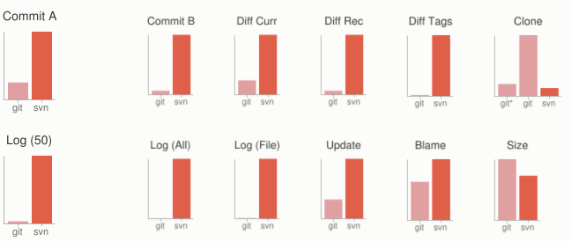
GIT design goals and Advantages
Nearly all operations local Was intended for linux codebase, hence speed and performance design goal from the start.

Slide 7
GIT design goals and Advantages
Distributed.
Multiple backups
Many workflows, SVN style, Integration Manager, Dictator – Lieutenants workflow

Slide 8
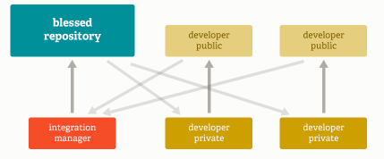
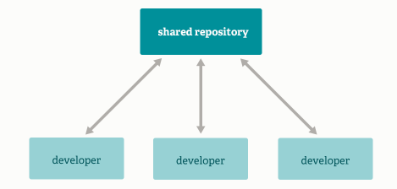
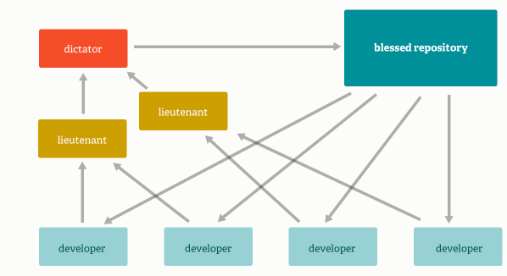
GIT design goals and Advantages

Slide 9
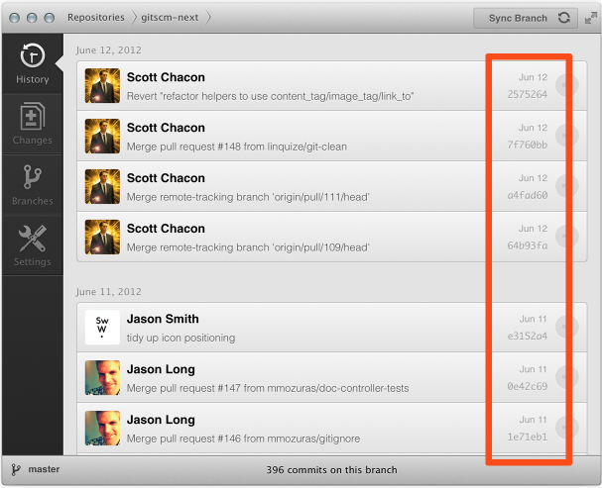
GIT design goals and Advantages
Data Assurance.
cryptographic integrity

Slide 10
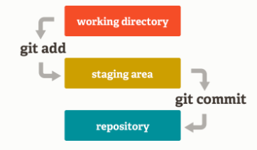
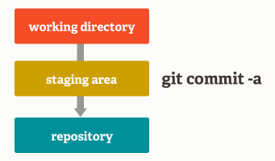
GIT design goals and Advantages
Staging Area
If don’t like then bypass…

Slide 11

GIT design goals and Advantages
Branching and Merging
Frictionless Context Switching
Role-Based Codelines.
Feature Based Workflow.
Disposable Experimentation.

Slide 12
Think like GIT design goals and Advantages
Free and Open Source, yay !

Slide 13
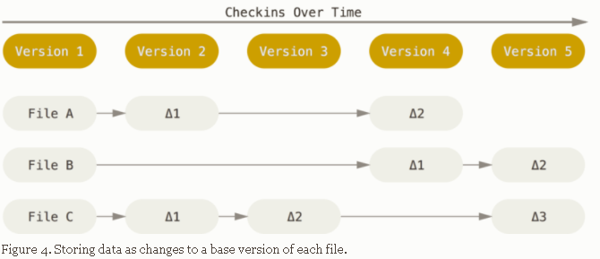
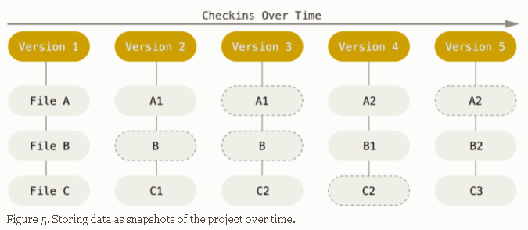
Think Like GIT (and not SVN)
Snapshots, Not Differences

Slide 14
Think Like GIT (and not SVN)
Nearly Every Operation Is Local
… Entire history since you took (cloned) repository is present locally, make commits, merge branches etc. no network needed.
Integrity : everything is checksummed with SHA1 impossible to change anything without GIT detecting it.

Slide 15
GIT in nutshell… “I know… enough history lessons “☺
modified staged committed ^ Stages that a file can exist in git ^

Slide 16
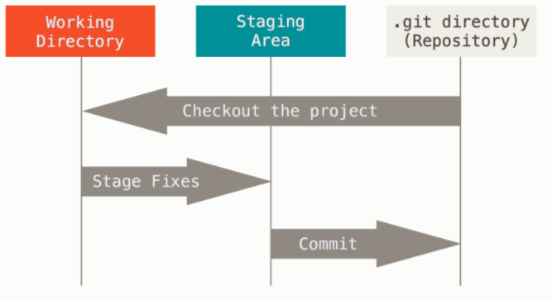
GIT in nutshell…
modified staged committed ^ Stages that a file can exist in git ^

Slide 17
file that stores information about what will go into your next commit -> snapshot ->local DB/repository
single checkout of one version what we see and work with
metadata &
object database
modified staged committed ^ Stages that a file can exist in git ^

Slide 18
file that stores information about what will go into your next commit -> snapshot ->local DB/repository
Clone
single checkout of one version what we see and work with
push
metadata &
object database
Don’t forget, Im local ☺
modified staged committed ^ Stages that a file can exist in git ^

Slide 19
Getting started
-- install
-- git-bash / git-cmd / git-GUI
__________________________________________________
GUIs for GIT
( tortoiseGIT, githubDesktop, SourceTree etc…)
__________________________________________________
git config
$ git config --global user.name "John Doe"
$ git config --global user.email johndoe@example.com
$ git config --list
git help <git-command>

Slide 20
Get a Git repository
In an existing directory
git init Cloning an existing repo from server.
git clone [url]
Notes:
If you’re familiar with other VCS systems such as Subversion, you’ll notice that the command is "clone" and not "checkout". This is an important distinction – instead of getting just a working copy, Git receives a full copy of nearly all data that the server has. Every version of every file for the history of the project is pulled down by default when you run git clone.
if your server disk gets corrupted, you any of the clones on any client to set the server back

Slide 21
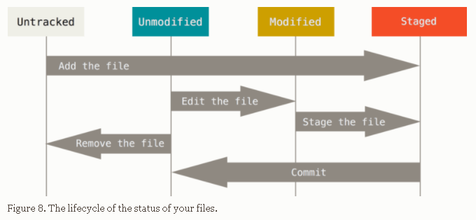
Recording changes to a Git repository

Slide 22
Recording changes to a Git repository
git status
git add
.gitignore file
git diff
git diff --staged
git commit
git rm
git rm –cached
git mv
Notes:
Git status –s flag
*.[oa]
*~
To see what you’ve changed but not yet staged, type git diff (wd vs stagingarea)
what you’ve staged that will go into your next commit, you can use git diff –staged (last commit vs staging)
Commit –a flag auto add all tracked files…

Slide 23
Viewing history in Git
git log
Notes:
Git Log -p -3 --all --stat --pretty=[format]
--graph
--oneline
--decorate
--since and --until
-S str

Slide 24
Undoing things
To amend previous commit git commit --amend
To unstage
git reset HEAD <file>
To discard a modified file
git checkout -- <file>

Slide 25
Working with Remotes
git remote [-v]
git remote add <shortname> <url>
git fetch <remotename>
git pull // = fetch+merge from remote
git push [remote-name] [branch-name]
git remote show <remotename>
git remote rename <old> <new>
git remote remove <remotename>
Notes:
Origin is remote added by default when cloning from a server
Fetch –all

Slide 26
Branching
“Unlike many other VCSs, Git encourages workflows that branch and merge often, even multiple times in a day. Understanding and mastering this feature gives you a powerful and unique tool and can entirely change the way that you develop.” -- wise words in the GIT documentation

Slide 27
Branching
git branch [-v] git branch <branchname>
Git branch –d <branchname>
HEAD pointer
git checkout <branchname>
Notes:
, --no-merged, --merged

Slide 28
Merging
git merge <branch-to-merge-in>

Slide 29
Nearing end…
(Workflow review)
Notes:
Merge ourselves and push vs merge on server after push.

Slide 30
Appendix ?
..git rebase
..remote tracking advanced concepts, remote branch management, configuring multiple remotes for fetch/push ..git on server -> configuring gitlab, github etc. configuring read/write access, ssh keys …
..tags
..aliases
..commit stashing

Slide 31
Tags
git tag

Slide 32
Aliases
Eg.
git config --global alias.ci commit
>>ci –m “commitmessage”

